Slide 1


Time Series Forecasting
Group Members:
1- Shreeraj Kadam
2- Swapnil Kulkarni
3- Prateek Das
4- Ravi Bagul
5- Gokul Avhad
6- Pawan Shetty
Project Mentor – Ms. Munmum Bhagat

Slide 2

Business Problem:
To understand the Air Quality in Delhi, in particular we are looking at the Particulate Matter presence in the Air, The given date expands for a period of over 4 months. The dataset has hourly measures of PM values
(Fine particles (PM_{2.5}) pose the greatest health risk. These fine particles can get deep into lungs and some may even get into the bloodstream. Exposure to these particles can affect a person's lungs and heart)
Objective:
Our Objective is to predict / forecast the value of PM presence in the air over the period of next 24 hours in Delhi.
.

Slide 3
Project Architecture / Project Flow
Data collection and summarization
Exploratory Data Analysis
Data Modelling and checking for Accuracy
Visualization and Communicating the predicted/forecasted values
Deployment
Defining and Understanding Business Objective

Slide 4
Exploratory Data Analysis (EDA) and
Feature Engineering

Slide 5
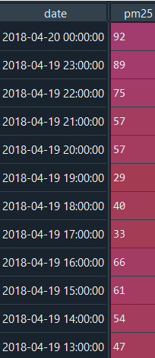
Data set details
Number of Rows=2374
Number of Columns=2
Unique values = 503
Date ranges : 01-01-2018 to
20-04-2018
Missing values : 80
Column Names- Dates and PM25

Slide 6
Exploratory Data Analysis (EDA)
In EDA, we have noted the following -
There are about 80 missing values pm25 column
There is a negative trend in pm25.
The PM25 values are significantly higher during the late hours of the day, which contradicts the idea that “pm25 values should be higher during the peak office hours”
There is a seasonality trend.
Once the NA values are imputed, the line chart shows a negative trend as well
Imputation of the missing numbers have been done using interpolation technique.
On analysis of day wise data it seems that Thursday is one weekday when the PM value seems to be higher.
There seems to be no outliers

Slide 7
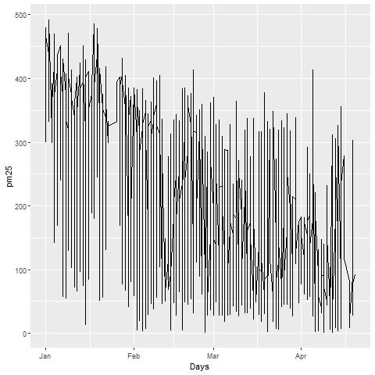
Plots Created during the process of EDA
A Line chart post imputation of the missing values, this clearly shows a decreasing trend. The x axis has the months, and the y axis has the pm 25 values.

Slide 8
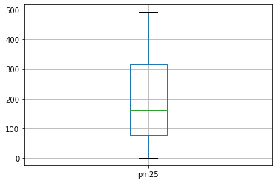
Plots Created during the process of EDA
A box plot showing the average of the PM values. There seems to be no outliers.

Slide 9
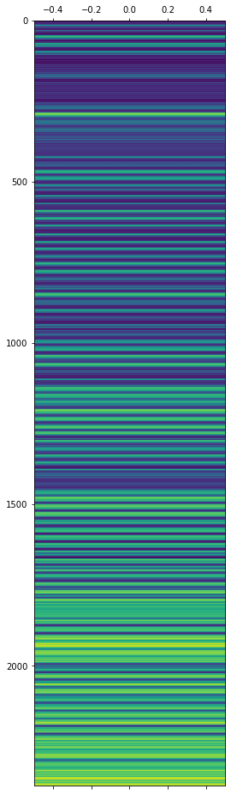
Plots Created during the process of EDA
Heat Map- Made to check the distribution of the data..

Slide 10
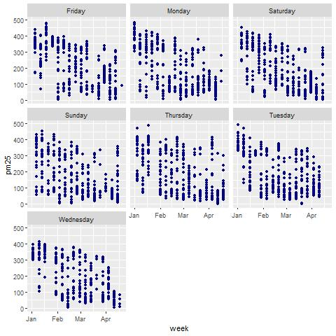
Plots Created during the process of EDA
Weekday wise distribution using a line chart

Slide 11
Making data uniformly spaced
Data contains 2617 values
NA values present is 244
3) Filled the na values interpolate method.

Slide 12
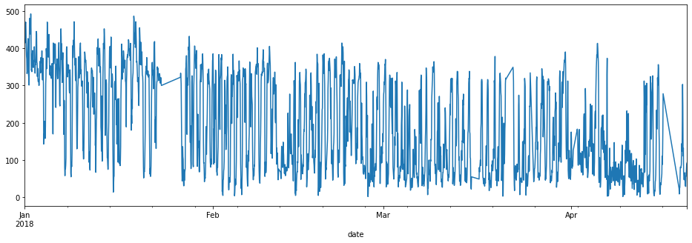

Slide 13
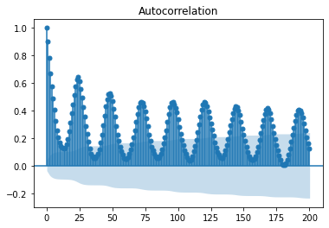

Slide 14
Additional EDA
1) The Data is not stationary , Data is made stationary via seasonal differencing.

Slide 15
Adfuller Test Results
ADF statistic: -14.064971
p-value:0.000000
Critical Values:
1%:-3.433
5%:-2.863
10%:-2.567
This proved that the data is stationary

Slide 16
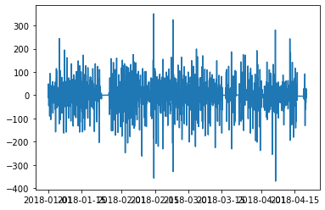
Time plot after making Data stationary

Slide 17
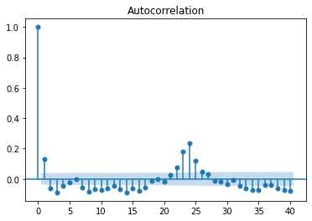
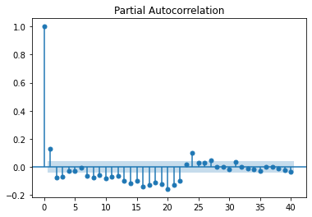
ACF and PACF plots

Slide 18
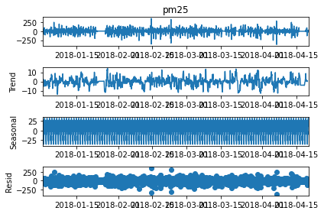
Decomposition plot

Slide 19
Model Building
Model | RMSE Value
Linear Model | 200.134
Exponential Model | 170.712
Quadratic | 250.34435
Additive seasonality | 120.784
Additive Seasonality Quadratic | 160.236
Multiplicative Seasonality | 114.442
Multiplicative Additive Seasonality | 109.334
Model | RMSE Value
Simple Exponential Method | 98.1
Holt method | 135.446
Holts Exp and Additive Seasonality | 97.11
Arima (1,0,1) | 80.2
Arima (1,1,1) | 97.1
Sarima (1,1,1)(1,1,1,24) | 56.34
Sarima (1,0,1)(1,0,1,24) | 41.23

Slide 20
Model – SARIMA
Data set details:
We have segregated our dataset into 70 and 30 %, 70 being for training and 30 being for validation.

Slide 21
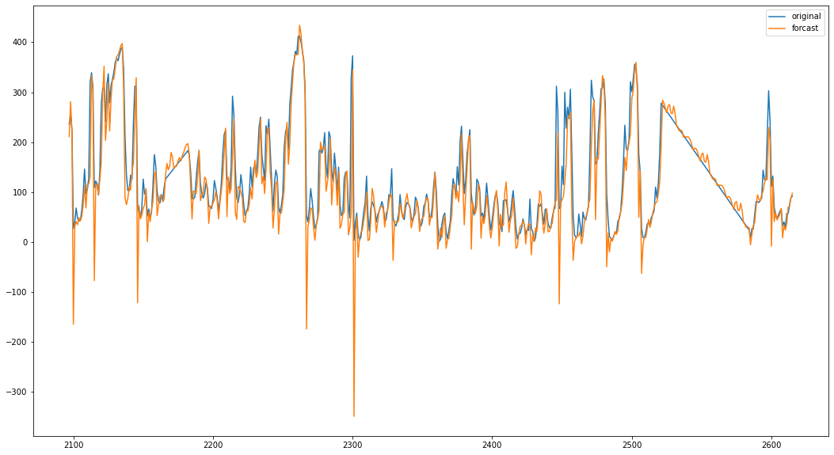
Plot on Original and predicted values

Slide 22
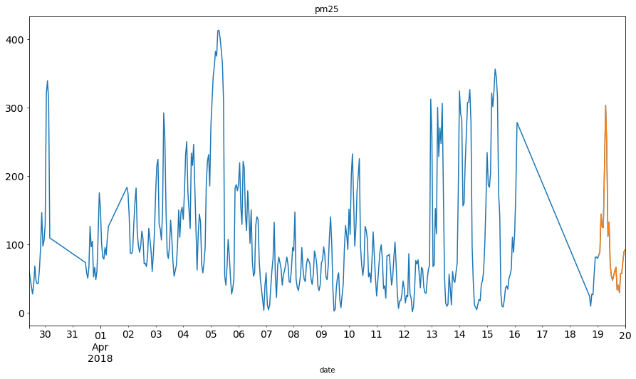
Forecasted value of next 24 hours ,not present in dataset

Slide 23
Model Deployment using R shiny / Flask or any other method

Slide 24
Challenges faced?
How did you overcome?

Slide 25
Thank you

